Slide 1
Title: Human Activity Recognition: Gender Recognition by Voice Institution: Northwood University Professor: Dr. Mighty Itauma Team Members: Prathyusha Devari, Bhavana Mulaka, Amool Siri S

Slide 2
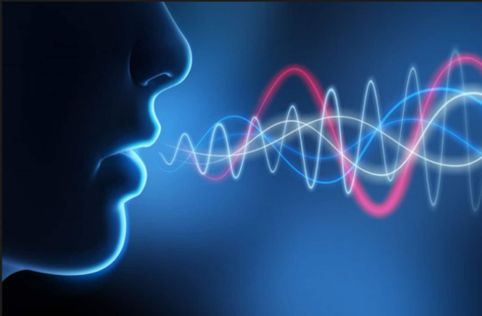
INTRODUCTION
Voice data plays a critical role in virtual assistants and speech recognition.
Key challenges: classification and clustering of voice data.
Goal: Investigate how machine learning models (Logistic Regression, K-means, DBSCAN) can classify gender by voice.

Slide 3
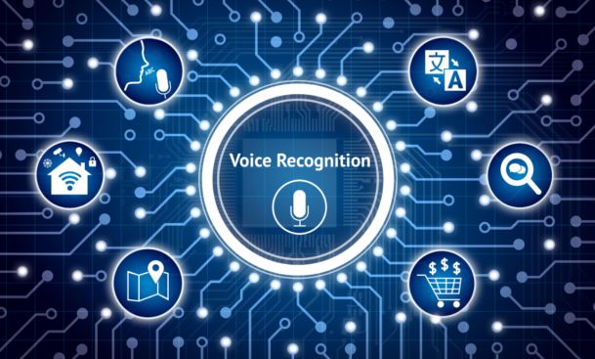
Dataset and Features
Dataset: Voice samples labeled male or female.
Key Features:
Mean frequency, Standard deviation, Median, Skewness, Entropy, etc.
Preprocessing: Label encoding, standardization.

Slide 4
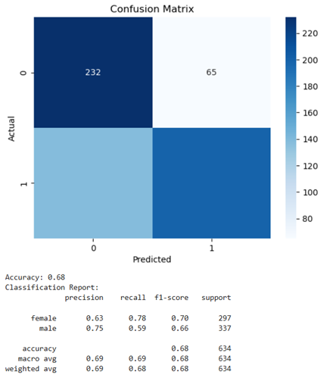
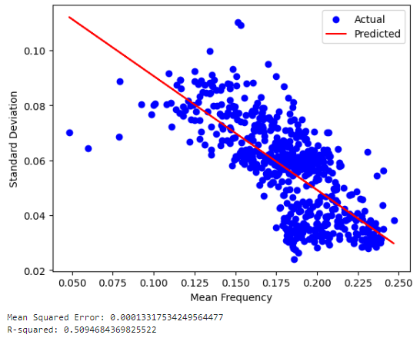
Methodology
Classification:
Logistic Regression (Data split: 80% training, 20% testing).
Achieved 68% accuracy.

Slide 5
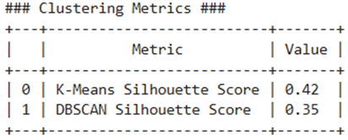
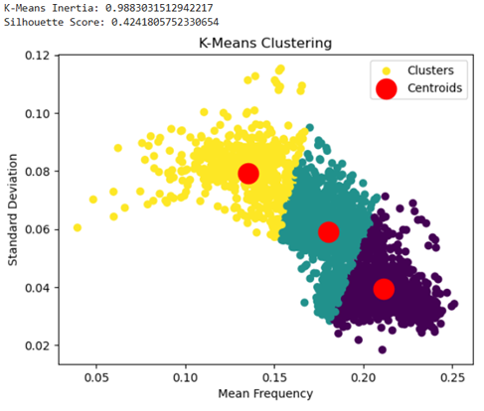
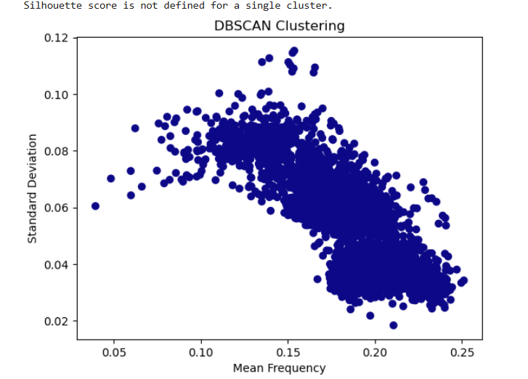
Clustering:
K-means clustering (3 clusters, silhouette score: 0.42).
DBSCAN (Found one large cluster).

Slide 6
Results and Conclusion
Logistic Regression: Moderate accuracy (68%).
K-means: Moderate cluster separation.
DBSCAN: Ineffective for this dataset.
Future work: Explore SVM, CNNs, and advanced clustering methods.

Slide 7

Thank you.…

Slide 8
Questions……???

